Slide 1
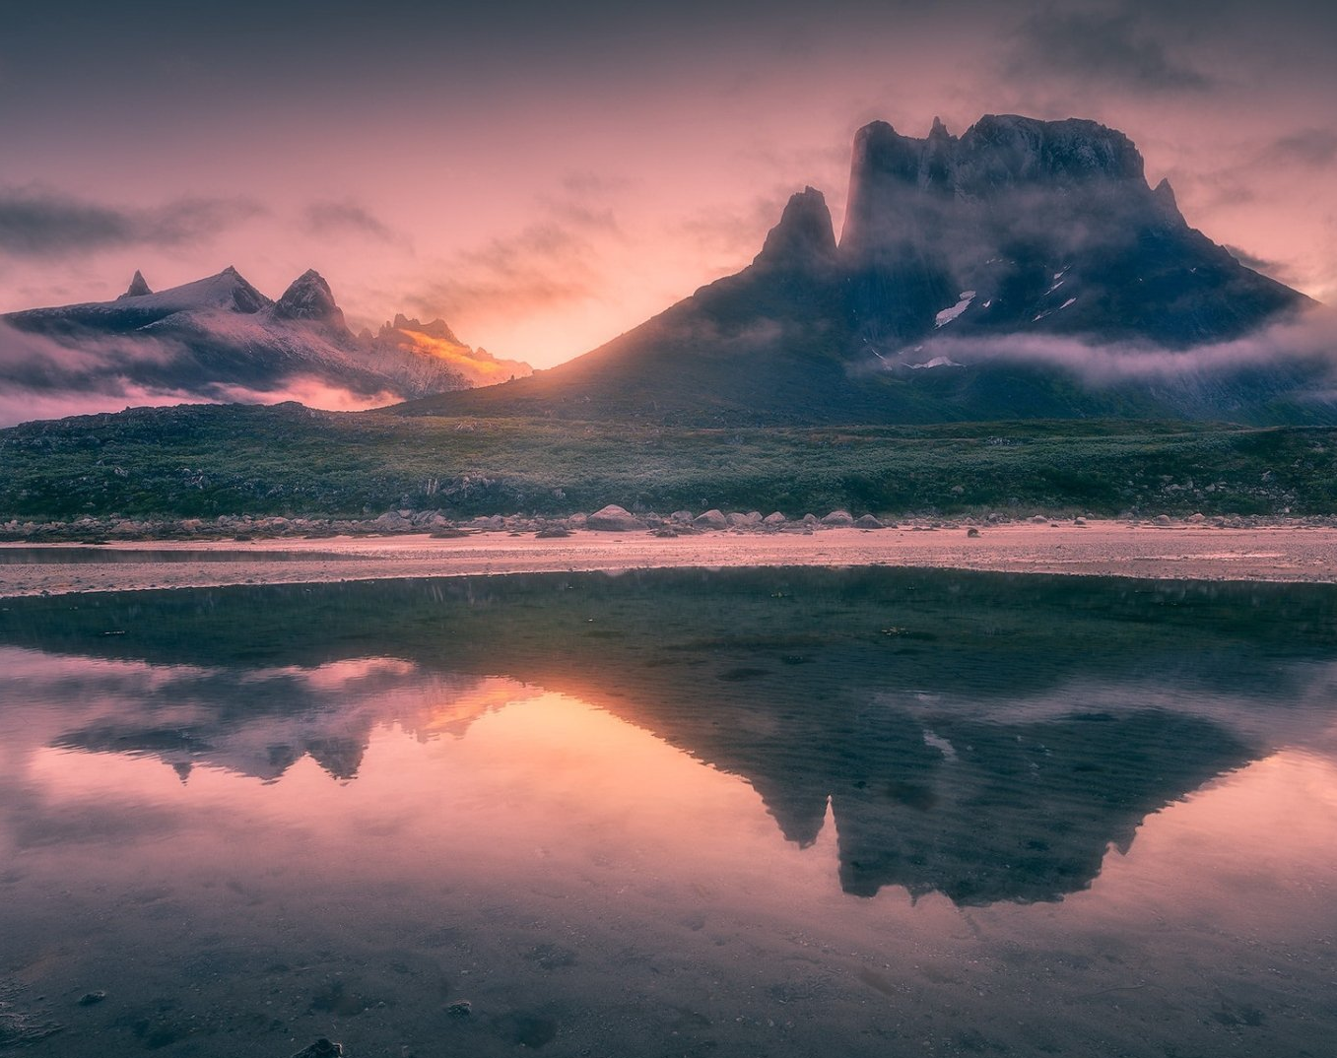
His Mercy is More

Slide 2
G C G Em D C G Em
Praise the Lord, His mercy is more C D D Em
Stronger than darkness, new every morn
C G D G
Our sins they are many, His mercy is more

Slide 3
G
What love could remember,
C G
no wrongs we have done
D Em
Omniscient all-knowing,
C D
He counts not their sum

Slide 4
G Am
Thrown into a sea,
G C
without bottom or shore
C G
Our sins they are many,
D G
His mercy is more

Slide 5
G C G Em D C G Em
Praise the Lord, His mercy is more C D D Em
Stronger than darkness, new every morn
C G D G
Our sins they are many, His mercy is more

Slide 6
G C G
What patience would wait as we constantly roam
D Em C D
What Father so tender is calling us home
G Am G C
He welcomes the weakest, the vilest, the poor
C G D G
Our sins they are many, His mercy is more

Slide 7
G C G Em D C G Em
Praise the Lord, His mercy is more C D D Em
Stronger than darkness, new every morn
C G D G
Our sins they are many, His mercy is more

Slide 8
G C G
What riches of kindness He lavished on us
D Em C D
His blood was the payment, His life was the cost
G Am G C
We stood 'neath a debt we could never afford
C G D G
Our sins they are many, His mercy is more

Slide 9
G C G Em D C G Em
Praise the Lord, His mercy is more C D D Em
Stronger than darkness, new every morn
C G D G
Our sins they are many, His mercy is more
REPEAT & END

Slide 10
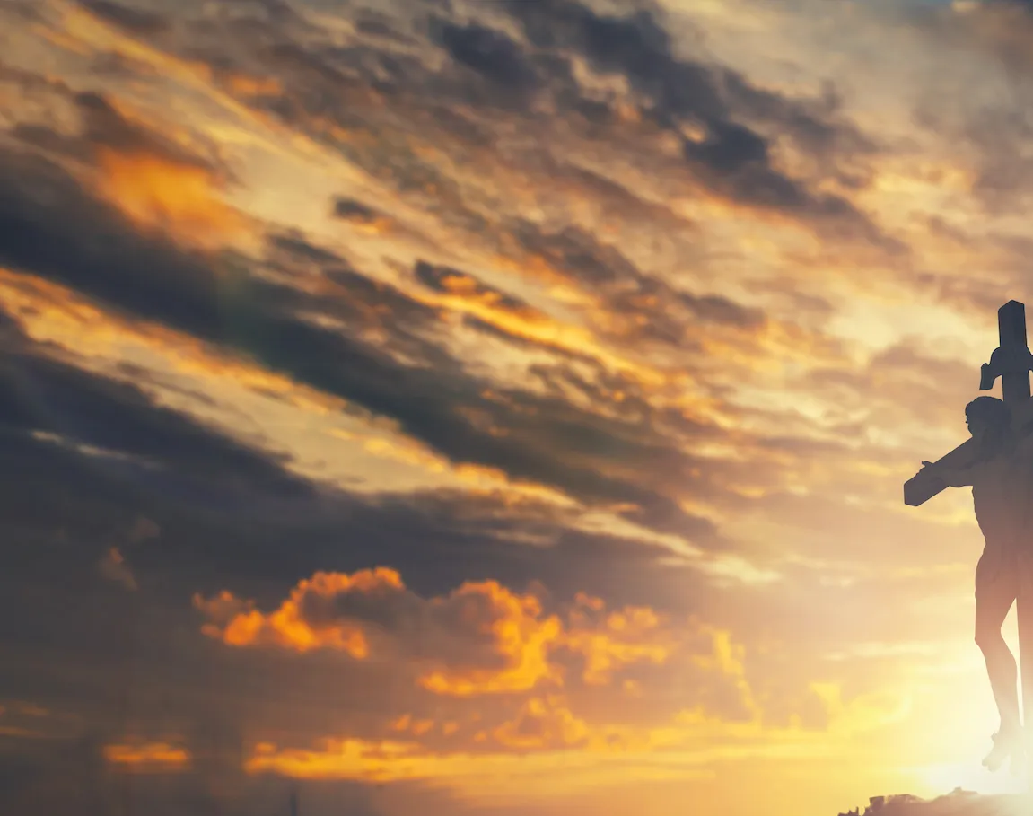
Great is Thy Faithfulness

Slide 11
C F Am G
C F G C
Great is thy faithfulness, O God my Father,
F C D G
There is no shadow of turning with Thee;
G C Dm
Thou changest not, Thy compassions they fail not
F C G C
As Thou has been Thou forever wilt be

Slide 12
G C
Great is Thy faithfulness,
Am Dm
Great is Thy faithfulness,
G C D G
Morning by morning new mercies I see
G C Dm
All I have needed Thy hand hath provided
F C G C
Great is Thy faithfulness, Lord unto me

Slide 13
C F G C
Summer and winter, and springtime and harvest,
F C D G
Sun, moon and stars in their courses above,
G C Dm
Join with all nature in manifold witness
F C G C
To Thy great faithfulness, mercy and love

Slide 14
G C
Great is Thy faithfulness,
Am Dm
Great is Thy faithfulness,
G C D G
Morning by morning new mercies I see
G C Dm
All I have needed Thy hand hath provided
F C G C F Am G
Great is Thy faithfulness, Lord unto me.

Slide 15
C F G C
Pardon for sin and a peace that endureth,
F C D G
Thy own dear presence to cheer and to guide
G C Dm
Strength for today and bright hope for tomorrow
F C G C
Blessings all mine, with ten thousand beside

Slide 16
G C
Great is Thy faithfulness,
Am Dm
Great is Thy faithfulness,
G C D G
Morning by morning new mercies I see
G C Dm
All I have needed Thy hand hath provided
F C G C Am F G
Great is Thy faithfulness, Lord unto me
END

Slide 17
Above All

Slide 18
CAPO 2nd
C D G
Above all powers, above all Kings
C D G
Above all nature, and all created things
Em D C G
Above all wisdom, and all the ways of man
Am D G
You were here before the world began

Slide 19
C D G
Above all kingdoms, above all thrones
C D G
Above all wonders this world has ever known
Em D C G
Above all wealth and treasures of the earth
Am C B
There's no way to measure what You're worth

Slide 20
G Am D G
Crucified, laid behind a stone
G Am D G
You lived to die, rejected and alone
Em D C G
Like a rose, trampled on the ground
Am G C D G
You took the fall, and thought of me Above all

Slide 21
C D G
Above all powers, above all Kings
C D G
Above all nature, and all created things
Em D C G
Above all wisdom, and all the ways of man
Am D G
You were here before the world began

Slide 22
C D G
Above all kingdoms, above all thrones
C D G
Above all wonders this world has ever known
Em D C G
Above all wealth and treasures of the earth
Am C B
There's no way to measure what You're worth

Slide 23
G Am D G
Crucified, laid behind a stone
G Am D G
You lived to die, rejected and alone
Em D C G
Like a rose, trampled on the ground
Am G C D G
You took the fall, and thought of me Above all
Play x2

Slide 24
Em D C G
Like a rose, trampled on the ground
Am G C D G
You took the fall, and thought of me Above all
END

Slide 25
Only A Holy God

Slide 26
Am / C / F / C CAPO 2nd for Marina, Skyler
Am C F C
Who else commands all the hosts of heaven
Am C F C
Who else could make every king bow down
Am C F C
Who else can whisper and darkness trembles
F G C
Only a Holy God

Slide 27
Am C F C
What other beauty demands such praises
Am C F C
What other splendour outshines the sun
Am C F C
What other majesty rules with justice
F G C
Only a Holy God

Slide 28
Am F
Come and behold Him
C G
The One and the Only
Am F
Cry out, sing holy
C G Am
Forever a Holy God
F G
Come and worship the Holy God

Slide 29
Am C F C
What other glory consumes like fire
Am C F C
What other power can raise the dead
Am C F C
What other name remains undefeated
F G C
Only a Holy God

Slide 30
Am F
Come and behold Him
C G
The One and the Only
Am F
Cry out, sing holy
C G Am
Forever a Holy God
F G
Come and worship the Holy God
x2

Slide 31
Am C F C
Who else could rescue me from my failing
Am C F C
Who else would offer His only Son
Am C F C
Who else invites me to call Him Father
F G C
Only a Holy God

Slide 32
Am F
Come and behold Him
C G
The One and the Only
Am F
Cry out, sing holy
C G Am
Forever a Holy God
F G
Come and worship the Holy God
END

Slide 33
Tis So Sweet To Trust in Jesus

Slide 34
G / D / C
G C
Tis so sweet to trust in Jesus;
Em D
Just to take Him at His word,
G C
Just to rest upon His promise
Em C D G
And to know, "Thus saith the Lord."

Slide 35
G D
Jesus, Jesus, how I trust Him!
Em D
How I've proved Him o'er and o'er.
G C
Jesus, Jesus, precious Jesus,
Em C D G
O for grace to trust Him more

Slide 36
G C
O how sweet to trust in Jesus;
Em D
Just to trust His cleansing blood,
G C
And in simple faith to plunge me
Em C D G
'neath the healing, cleansing flood

Slide 37
G D
Jesus, Jesus, how I trust Him!
Em D
How I've proved Him o'er and o'er.
G C
Jesus, Jesus, precious Jesus,
Em C D G
O for grace to trust Him more

Slide 38
G C
Yes, 'tis sweet to trust in Jesus;
Em D
Just from sin and self to cease,
G C
Just from Jesus simply taking
Em C D G
Life and rest, and joy and peace.

Slide 39
G D
Jesus, Jesus, how I trust Him!
Em D
How I've proved Him o'er and o'er.
G C
Jesus, Jesus, precious Jesus,
Em C D G
O for grace to trust Him more

